Slide 1
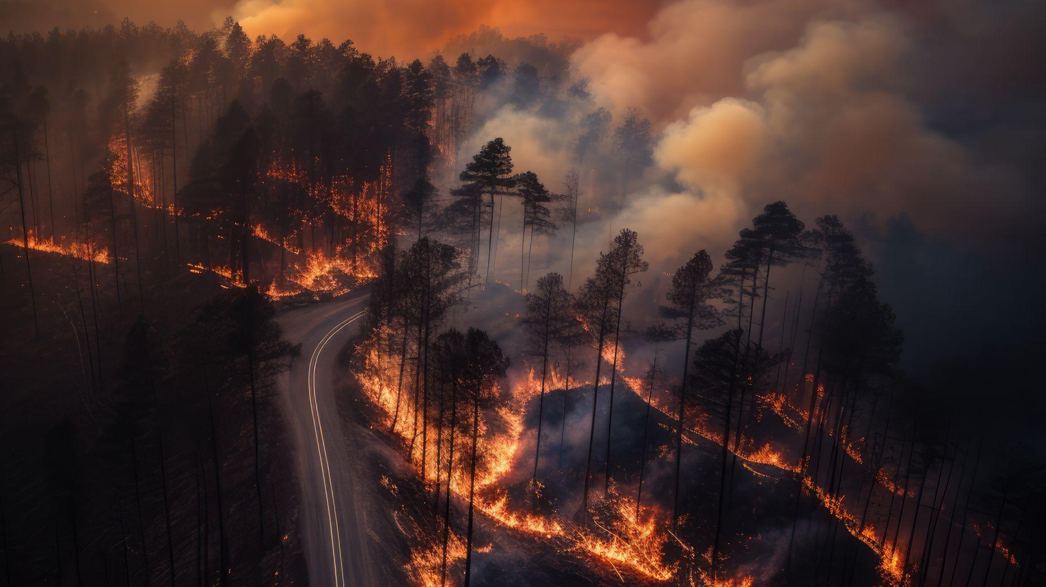
WILDFIRE EVENT
Operation Management Project – Preparation & Execution
Presented by | Student ID
Tzu Hsin Chang | N01701752
Wei-Wei Chiang | N01683386
David Lake | N01698267
Kuppan Murugappan | N01694284
Trung Viet Nguyen | N01704583
Dario Pineda | N01708235
Rajkumar Ramu | N01705840
Srivatsav Shrikanth | N01679678
December 2, 2025
Instructor: Prof. Trevor Smith

Slide 2
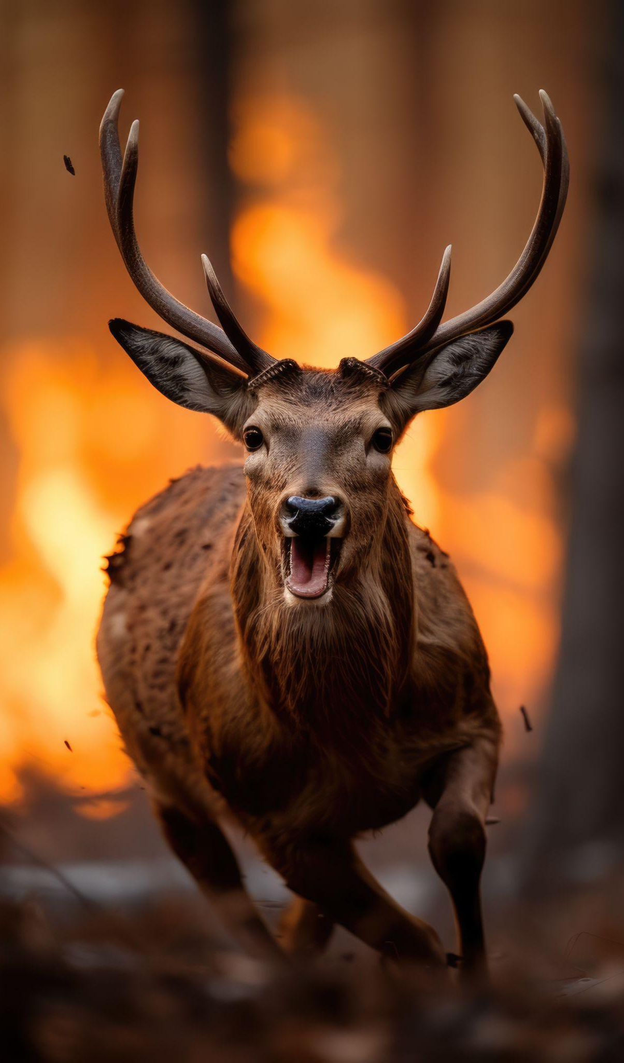
TABLE OF CONTENTS
01
02
03
04
05
06
07
08
Introduction
Inputs Required
Resource & Emergency Readiness
Benchmarking of Similar Scenarios
Project Process Design
TWO Scenario Descriptions
Metrics to Be Measured
Scenario specific measurement plan
09
Management by Fact Template

Slide 3
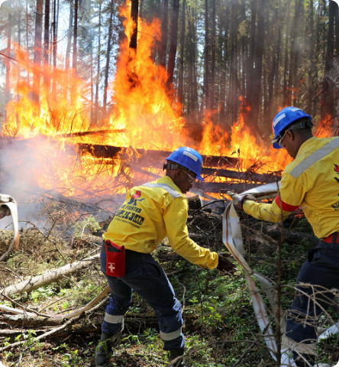





Introduction
Strategic Wildfire Operations Plan
A Data-Driven Response to Canada's Evolving Climate Threats
In 2025.....
6,000 wildfires reported all across Canada
83,000 km² affected by the fires
85,000 people evacuated + 2 deceases
Defined metrics-based framework for this kind of emergencies
Figure #1: Alberta wildfire firefighters
https://news.microsoft.com/source/features/ai/ai-alberta-canada-wildfire-firefighting/0
Notes:
Reference: https://www.canada.ca/en/public-safety-canada/news/2025/10/government-of-canada-provides-update-on-2025-wildfires-as-support-continues.html

Slide 4
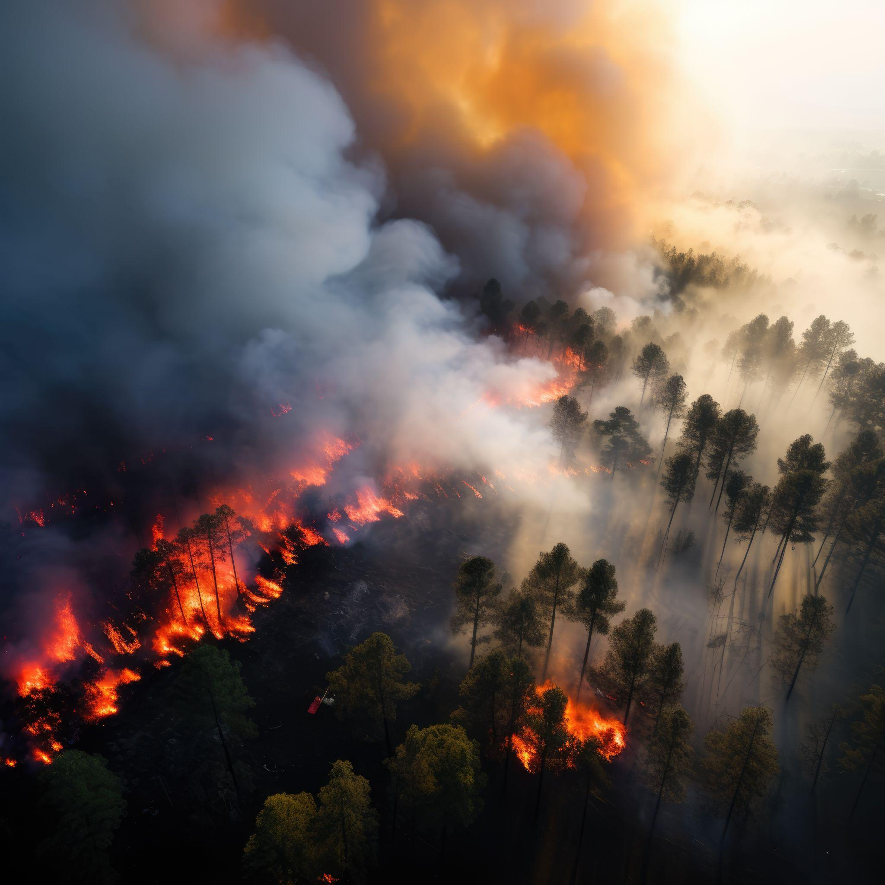
Project Process Areas
PART 01

Slide 5







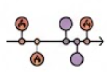
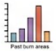


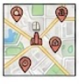

Inputs Required
Temperature
Humidity
Wind speed/direction
Lightning
Drought indices (FWI)
Weather & Climate
Past ignitions
Time to detection
Solving time
Total area
burned
Vegetation type fuel
Soil moisture
Slope/elevation,
Historical burn scars
Historical Incidents
Environmental & Topographic
Communities
Power lines
Water plants
Air-quality index
Community & Infrastructure
NASA FIRMS thermal hotspots
Drone imagery
Automated smoke cameras,
Mobile alert data
Technology & Remote Sensing

Slide 6
Benchmarking: Canadian Practices
Province | Key Practices | Relevance to Our Plan
British Columbia (BC) | Advanced wildfire forecasting Rapid initial attack Strong aerial suppression Clear evacuation alert levels Readiness metrics (crew/equipment) | Early detection & rapid response for Scenario 1 Readiness indicators (staffing/equipment) Forecasting-based escalation triggers
Alberta | High-resolution fire behavior modelling Cross-regional resource pooling Strong logistics & supply chain management Detailed post-event evaluations | Inter-agency coordination for Scenario 2 Mobilization & logistics KPIs Evaluation framework design
While BC did well in early suppression, Alberta is good at logistics highlights. These are two very different response models, and both of them are essential when designing Scenarios 1 and 2 in our plan.
Notes:
For Canada one, we benchmark wildfire practices focusing on British Columbia and Alberta, which represent two of the most mature systems in the country.
For British Columbia, BC is recognized for its advanced wildfire forecasting tools and rapid initial attack. Their use of aerial suppression and a structured evacuation alert system helps contain fires before they escalate. BC also monitors readiness through staffing and equipment availability indicators. These practices are highly relevant to Scenario 1, where early detection and quick suppression are critical for preventing a small fire from becoming a larger event.
And Alberta is related to Scenario 2, large, fast-moving fires that require coordination across multiple agencies. Alberta relies heavily on high-resolution fire behavior modelling, cross-regional resource pooling, and a strong logistics framework for equipment and fuel mobilization. They also conduct detailed post-season evaluations to refine their operational strategies.
These two states highlight different strengths: early suppression versus large-scale coordination. It directly informs the design of our own wildfire operational plan.

Slide 7
Benchmarking: International Practices
Province | Key Practices | Relevance to Our Plan
US California | Real-time satellite detection Unified Incident Command System (ICS) Evacuation traffic modelling | Communication & coordination KPIs Escalation & evacuation trigger design
Australia New South Wales | Community preparedness system Volunteer mobilization Standardized After Action Reviews | Readiness indicators Community impact metrics Structured post-event evaluation
International cases reveal advanced practices, such as ICS and community readiness, that Canada can adopt proactively as wildfire seasons intensify due to climate change.
Additional case: Portugal’s post-2017 wildfire reforms highlight the importance of centralized incident command and standardized community communication, showing how smaller nations adapt after catastrophic events.
Notes:
Internationally, we reviewed practices from California and the New South Wales Rural Fire Service in Australia.
California demonstrates advanced capabilities in real-time satellite detection and the use of the Incident Command System, which ensures a unified, multi-agency response. Their evacuation traffic modelling also provides insights on how to manage congestion during large-scale evacuations. These elements help guide our approach to communication KPIs and the development of clear escalation and evacuation triggers.
While Australia offers another perspective, with strong community-readiness programs, a large volunteer workforce, and standardized post-season reviews. These practices inform our readiness indicators and our approach to evaluating community impact and post-event performance.
As an additional case, we also examined Portugal’s 2017 wildfire reforms. Portugal experienced catastrophic fires, and the subsequent reforms emphasized the importance of centralized incident command and standardized community communication. Including this extra case helps broaden our international comparison and shows how smaller jurisdictions adapt their systems after extreme events.
Overall, the combined insights from Canada and international cases guide the forecasting, readiness, coordination, and evaluation components of our wildfire project plan.

Slide 8
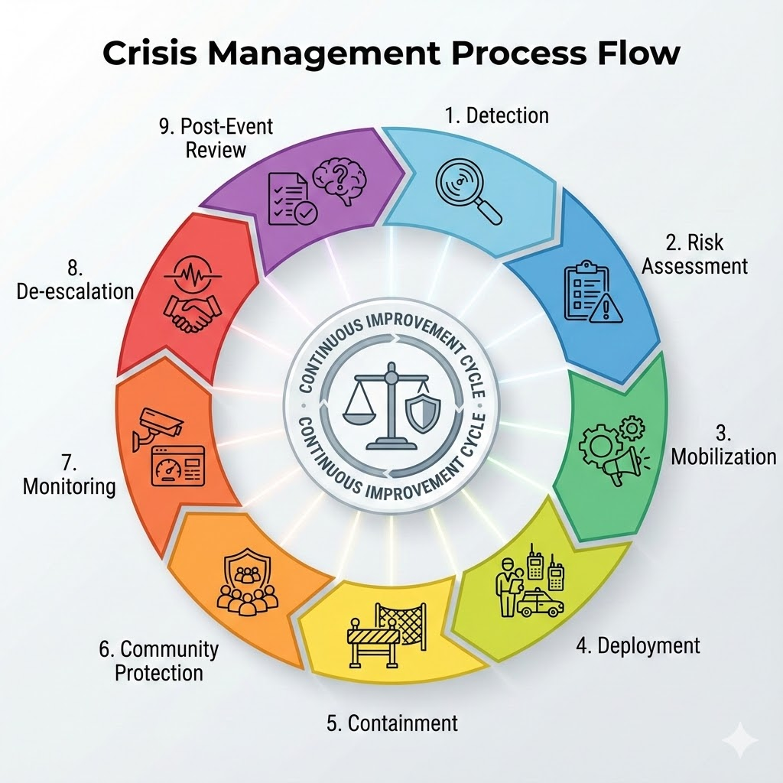
End-to-End Project Process Design - Wildfire Response
Uses data-driven triggers (wind, dryness, fire index, terrain risk) to activate the right response level.
Ensures resource-ready operations: crew availability, equipment health, fleet readiness, supply chain status.
Standardized SOPs and inter-agency workflows (fire crews, EMS, police, logistics, air operations).
Minimizes delays through early bottleneck identification: approval time, fuel supply, remote-area communication gaps.
Real-time command center for continuous monitoring, forecast updates, and resource reallocation.

Slide 9
Key Design Principles, Controls & Metrics
Design Principles
Control Elements
Performance Metrics
Clear stage ownership
Redundant equipment and staffing
Integrated mapping & forecasting
Scalable for small and large wildfire events
Continuous fire-spread & weather modelling
Unified reporting across teams
Dynamic re-tasking based on real-time risk
Time: detection → dispatch, arrival, containment
Resources: crew/fleet utilization, readiness %
Effectiveness: area protected, escalation accuracy
Safety: injury & equipment failure rates
Cost: daily burn cost, resource usage

Slide 10
Resource & Emergency Readiness
Category | Key Resources | Readiness & Action Protocols
Forecasting & Maps | • Sensors: Weather, wind, dryness, and smoke indicators • Maps: Terrain, key sites, and evacuation routes | • Pre-season: Calibrate and issue kits to crew leads • Backups: Paper maps in trucks / Offline maps on tablets
Equipment | • Tools: Extinguishers, Pulaskis, shovels, hoses, foam/gel • Safety: PPE and First-aid kits | • Deployment: Standard kit per crew / Spares near high-risk areas • Daily Supplies: 3,000 kcal food & 2L water per person
Fleet | • Air & Ground: Helicopters, water bombers, engines • Support: Dozers (for control lines) and ATVs (for patrol) | • Response: 20–30 min launch window; daily checks • Maintenance: Nightly refuel / 48-hour buffer for fuel/parts
Infrastructure & People | • Infra: Draft points, portable tanks, generators, radios • Teams: Fire crews, dispatch, mechanics | • Planning: Clear SOPs and action plans established • Staffing: Extra help on call / Mechanics on 24/7 cover

Slide 11
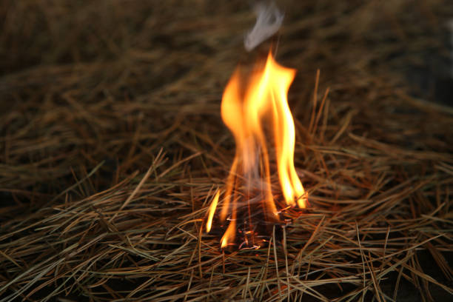
First Scenario Action Plan
Scenario 1: Small fire, contained but growing
Goal: Keep the fire small and reach containment within 48 hours. Triggers: Confirmed ignition or risk signals like low humidity, high wind, or fast spread. First hour: Confirm by tower, satellite, or drone, dispatch within 20 minutes, anchor the line, flank both sides, lay hose, and hit hotspots with water or foam. Resources: One 20-person initial-attack crew, Type-6 engine or skid unit, thermal drone, helicopter bucket if needed. Escalation: Add crews or aircraft when humidity drops below 20 percent, wind exceeds 30 km per hour, or spread is above 5 hectares per hour. KPIs: Dispatch time, first arrival time, percent contained in 48 hours, equipment use rate, safety incidents.

Slide 12
Second Scenario Action Plan
Scenario 2: Large, out-of-control fire + Evacuation
Goal: Protect people first, then critical sites and property, and stabilize the perimeter. Triggers: Fast spread toward communities or unsafe air quality alerts. First hour: Stand up unified command and the provincial EOC, push alerts in multiple languages, open several evacuation routes with checkpoints, move vulnerable groups first, and protect power and water sites. Resources: Multiple ground crews and aircraft, police for traffic, medical and shelter teams, buses and signs, cots and hygiene kits, water and food, HEPA purifiers, redundant communications. Escalation: Request inter-provincial and federal surge support when local capacity is at risk. KPIs: Percent evacuated within 12 hours, checkpoint flow and clearance time, shelter open time and occupancy, communications uptime, injuries avoided, number of protected assets, days that clean-air spaces are used.

Slide 13
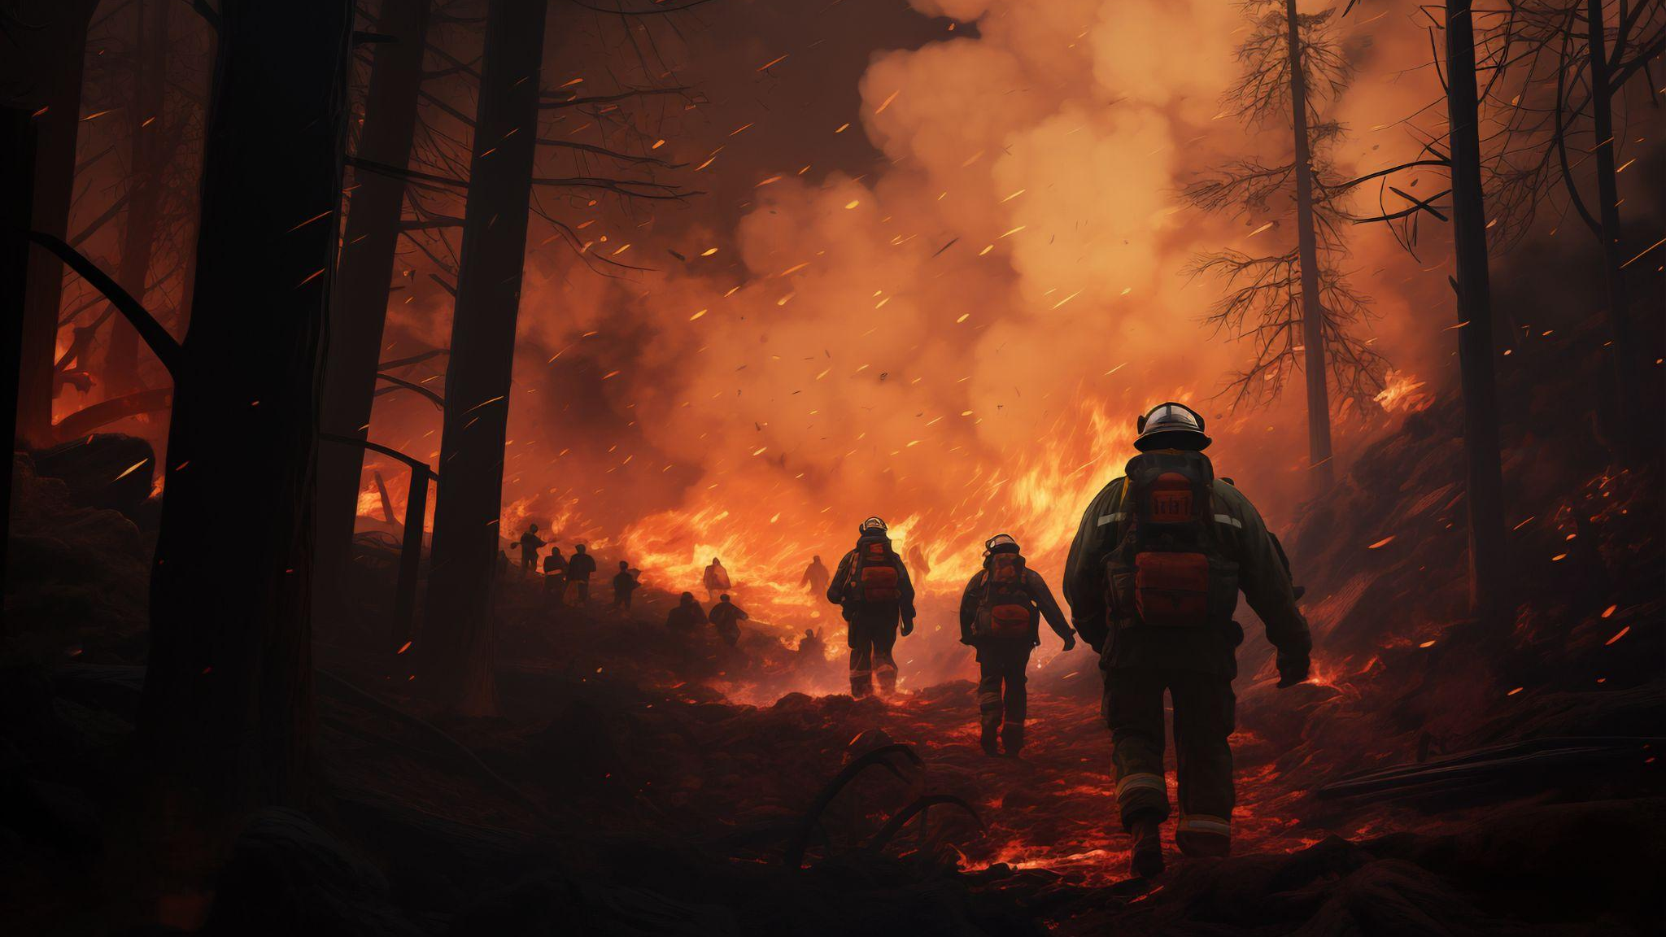
Wildfire Event Measurement Plan
PART 02

Slide 14
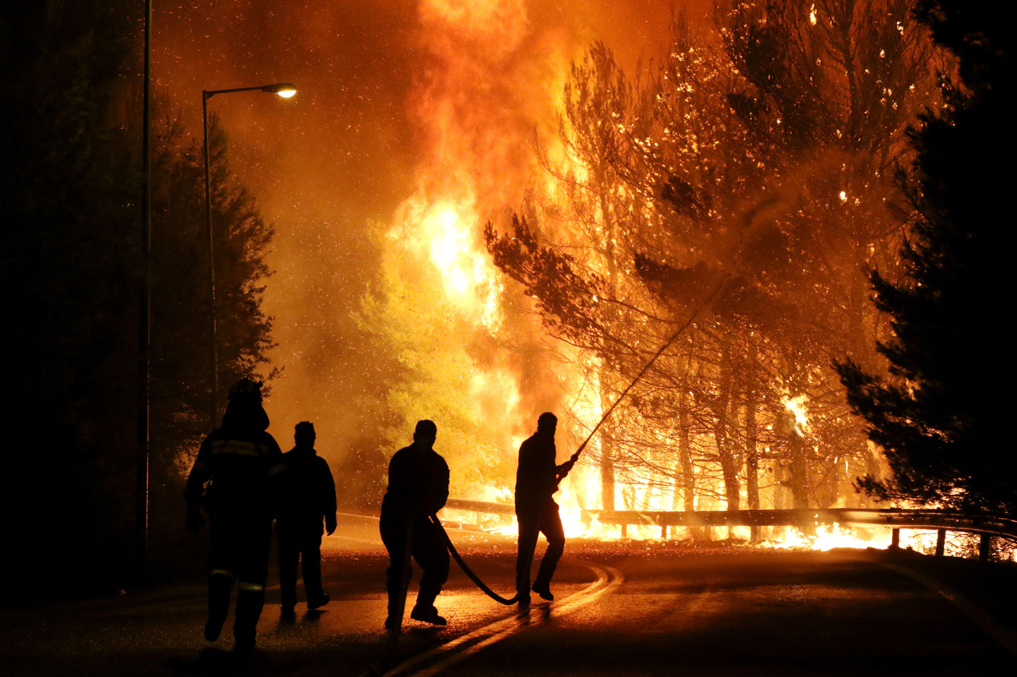

Measurement Plan Using the Toolbox of Metrics
Standardized Framework: Our metric design strictly follows the "Toolbox of Metrics" and integrates the 10 OM Decision Areas.
Operational Stages: Metrics are strategically organized into three phases:
Forecasting: Predicting risk (Before Event)
Execution: Monitoring operations (During Event)
Evaluation: Measuring outcomes (After Event)
This structure ensures a complete, data-driven cycle for wildfire prediction, response, and continuous improvement.
Figure #2 Firemen battle with the flames in Kalamos 2017.
https://www.carbonbrief.org/explainer-how-climate-change-is-affecting-wildfires-around-the-world/
“Metrics guide WHEN to respond, HOW to respond, and HOW WELL we responded”

Slide 15
Table of Metrics: Operational Phases
Stage | Decision Area | Metric Description | Target / Goal
 | Scheduling | Fire Weather Index (FWI) Measures potential fire intensity based on weather data | Accuracy > 90%
 | Inventory | Asset Readiness Score % of fleet (trucks/planes) ready for immediate deployment | 100% Availability
 | Human Resources | Response Time Elapsed time from alert receipt to team deployment | < 15 Minutes
 | Supply Chain | Resource Utilization Efficiency of water/retardant drops per hour | < 5% Idle Time
 | Quality | Containment Efficacy Percentage of wildfire contained within first 24 hours | 100% Containment
 | Maintenance | Recovery Turnaround Time required to restock and repair assets post-event | < 48 Hours
Forecasting
Forecasting
Execution
Execution
Evaluation
Evaluation

Slide 16
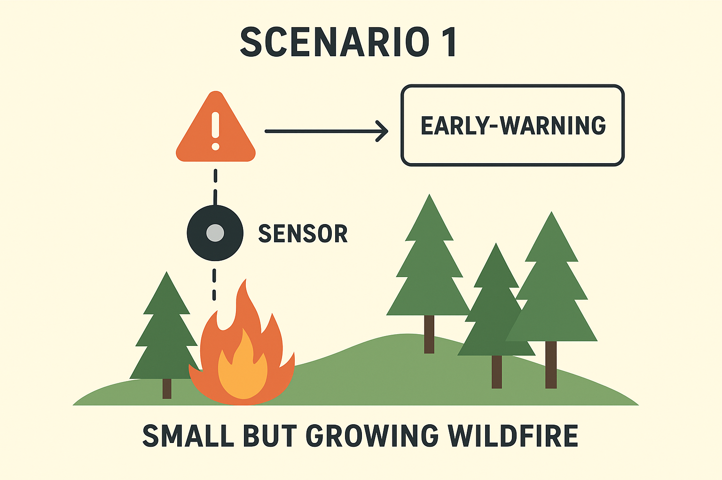
First Scenario Measurement plan
Focus: Early detection & fast containment
Metrics:
Forecasting Tools: FWI, SPI, Wind Speed, Fuel Dryness, MAD/MSE/MAPE, Tracking Signal
Capacity: Crew, aircraft, equipment availability
Scheduling: Deployment time, cycle time, shift adherence
Inventory: Water & fuel stock, days of supply
Quality: Safety KPI, error rate
Process/Productivity: Containment %, response time
Evaluation:
Compare predicted vs. actual growth
Identify gaps in response or resources
Execution:
Monitor fire spread vs. forecast
Escalate alerts when thresholds crossed
Adjust crew deployment
Small but growing fire🔥

Slide 17
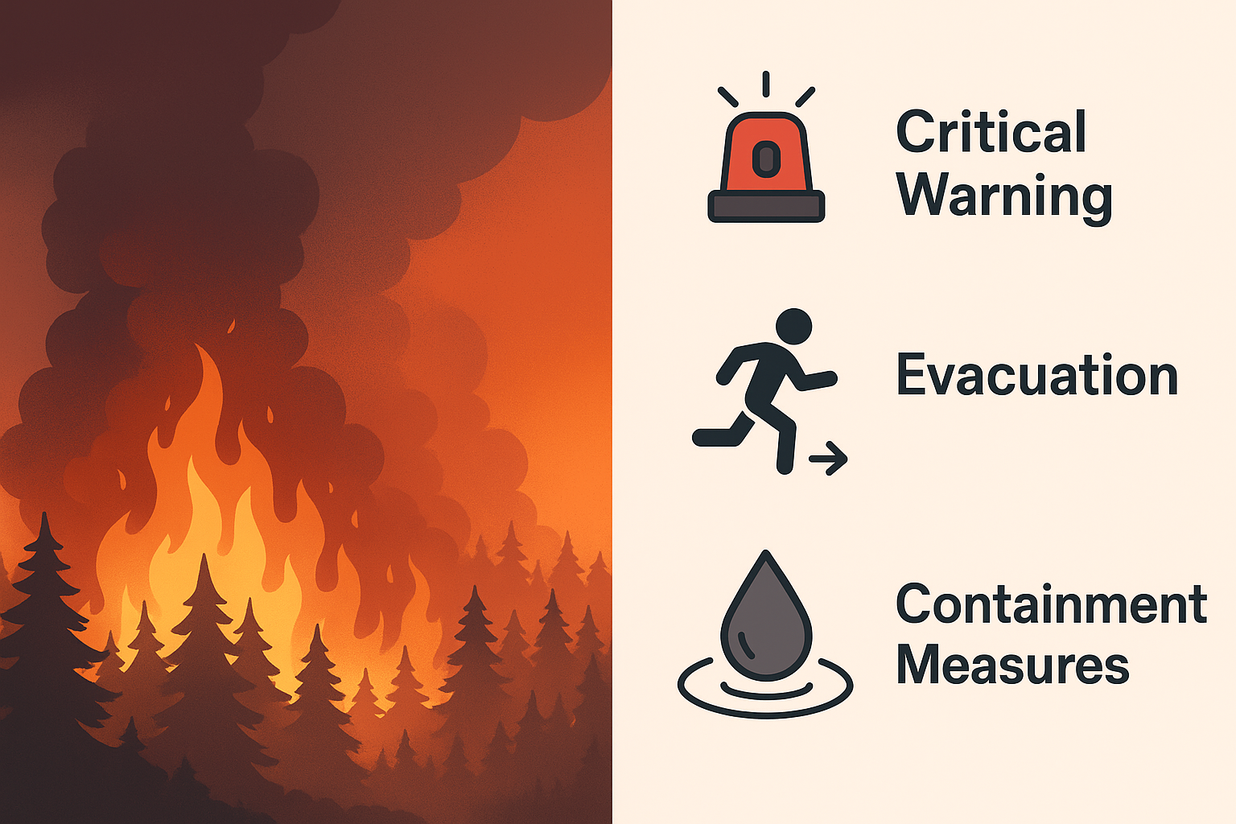
Second Scenario Measurement plan
Focus: Crisis management & multi-agency coordination
Metrics:
Forecasting Tools: FWI, SPI, Wind Speed, Fuel Dryness, MAD/MSE/MAPE, Tracking Signal
Capacity: Crew, aircraft, equipment utilization
Scheduling & HR: Deployment time, shift adherence, Training %, staffing availability
Supply Chain: Resupply time, supplier lead time, logistics delays
Inventory: Water inventory, fuel stock, days of supply
Quality: Safety KPI, error rate
Process/Productivity: Containment %, response time
Financial & Maintenance: Cost variance, schedule variance, Equipment readiness %, breakdown rate
Evaluation:
Post-event review of resource gaps
Analyze coordination, safety, and containment efficiency
Lessons for future large-scale fires
Large uncontrolled fire🔥🔥
Execution:
Continuous monitoring of resources & exhaustion
Multi-agency coordination
Track containment & response effectiveness

Slide 18
Wildfire Event Management by Fact
PART 03

Slide 19

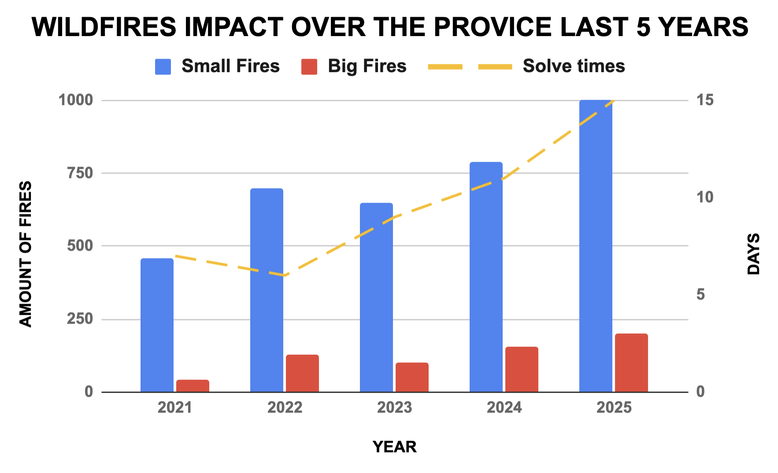
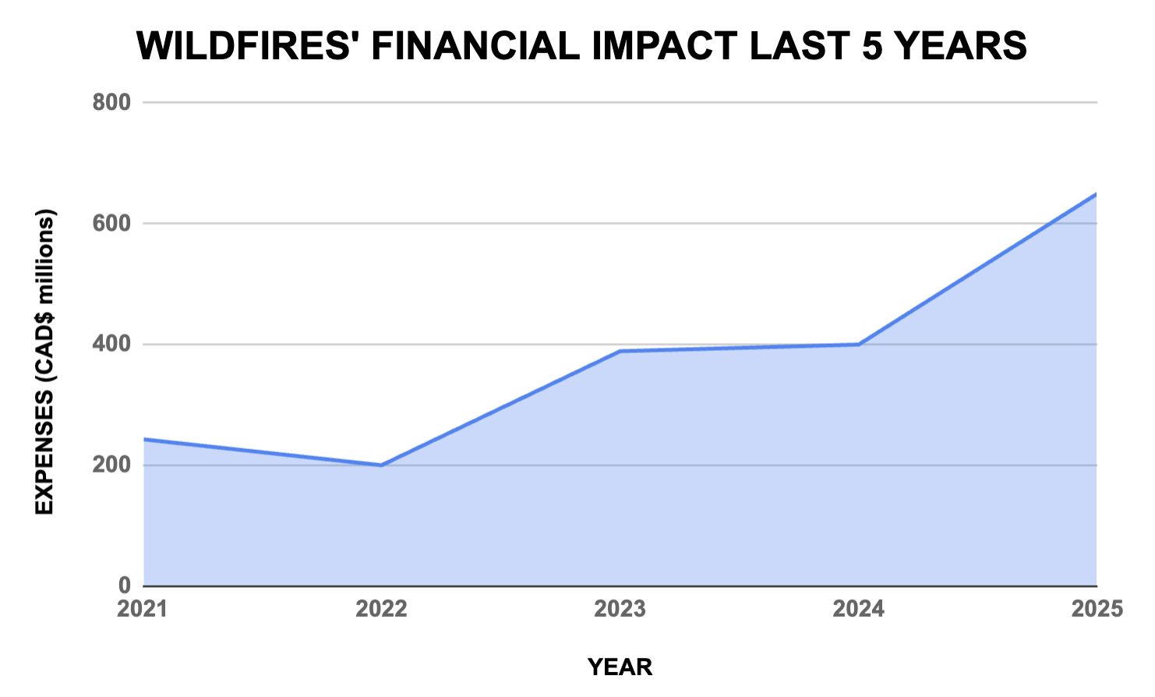
Management by Fact Plan
 | SMALL FIRE (A) | BIG FIRE (B)
PROBLEM STATEMENT | In 2025, provincial wildfires increased by 27% compared to 2024, while average solving times of First Responders rose by 19%, which represented an estimated $150 million dollars loss in property damage and $500 million dollars in repair expenses
PRIORIZATION & ROOT CAUSES | Fires are not detected on time Lack of training Forecasting accuracy Supply chain gaps | Fires are not controlled on time Civilians are not evacuated on time Mixed communications among parties Financial distress
COUNTERMEASURES | Real time monitoring dashboard Quaterly refreshers for first responders Retrain model to ensure 95% accuracy Increase buffer stocks | Real-time deployment systems Community fire drills per semester Develop and test contingency protocols Forecast budget levels per risk level
WHO | Forecasting analysts Operations' Manager | Local authorities Firefighters Government Financial department
WHEN | Daily measurements Quaterly trainings | In-moment and post-event

Slide 20


Conclusions
In response to the increasing number of wildfires in Canada, implementing specific measurable proactive well-planed strategies would allow an immediate impact over fire control operations by targeting fires as soon as they start and reduce the chances of them scaling into larger more destructive ones. Scenario 1 focuses on early detection while Scenario 2 focuses on crisis containment.
Using the metrics to be measured as a starting point allows for better operational process planning, as it clearly defines what needs to be achieved. Benchmarking practices also help tailor the containment plan to the affected province, ensuring that existing best practices can be leveraged without reinventing the wheel.
A structured Management By Fact report helps identify that increasing provincial wildfire annual expenses could be reduced by directly addressing its root causes (Lack of training, daily monitoring and forecasting accuracy) through the application of the measurable plans tailored to each one of the case scenarios ensuring accountability and cost-effective operations management.

Slide 21
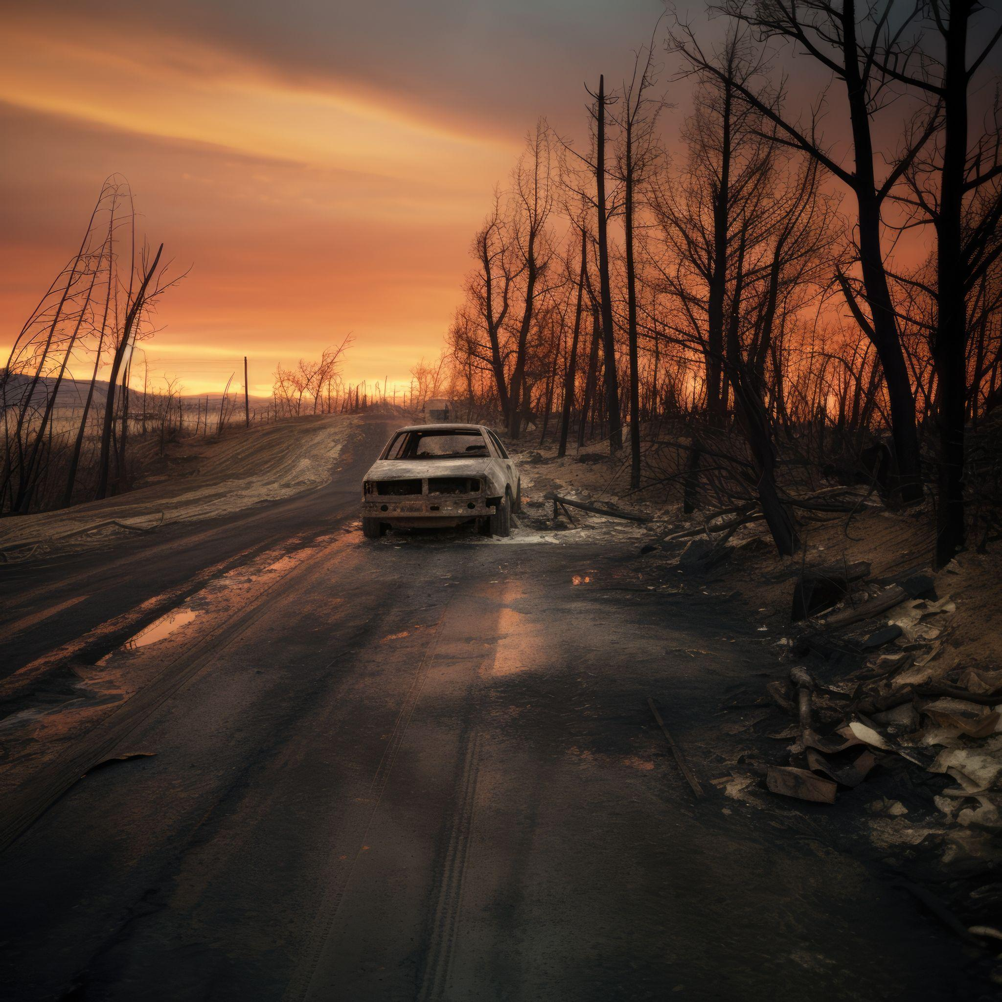
THANK YOU

Slide 22
References
Alberta Wildfire. (2025). Alberta.ca. https://www.alberta.ca/alberta-wildfire
BC Office of the Fire Commissioner. (2021). Annual Report 2021. https://www2.gov.bc.ca/assets/gov/public-safety-and-emergency-services/public-safety/fire-safety/fire-reporting/office_of_the_fire_commissioner_2021_annual_report.pdf
BC Wildfire Service. (2025). Wildfire Service - Province of British Columbia. https://www2.gov.bc.ca/gov/content/safety/wildfire-status
Beverly, J. L., & Schroeder, D. (2024). Alberta’s 2023 wildfires: context, factors, and futures. Canadian Journal of Forest Research, 55, 1–19. https://doi.org/10.1139/cjfr-2024-0099
NASA-FIRMS. (2025). NASA-FIRMS. https://firms.modaps.eosdis.nasa.gov/
Owens, D., O’Kane, M., & NSW Bushfire Inquiry. (2020). Final report of the NSW bushfire inquiry. https://www.bluemountains.org.au/documents/bushfires/final-report-of-the-nsw-bushfire-inquiry-31jul20.pdf
San-Miguel-Ayanz, J., Oom, D., Artès, T., Viegas, D. X., Fernandes, P., Faivre, N., Freire, S., Moore, P., Rego, F., & Castellnou, M. (2020). Forest fires in Portugal in 2017. In Super Case Study (Book EUR 30183 EN). Publications Office of the European Union, Luxembourg. https://doi.org/10.2760/571085
State of California. (2025). California Department of Forestry and Fire Protection | CAL FIRE. CAL FIRE. https://www.fire.ca.gov/

Slide 23
Introduction
Strategic Wildfire Operations Plan
A Data-Driven Response to Canada's Evolving Climate Threats
Context: Escalating wildfire frequency and severity across Canada due to climate change require a robust operational shift.
Methodology: Applies core Operations Management frameworks, including forecasting, capacity planning, and scheduling, to optimize resource readiness.
Scenario Planning: Validated against dual scenarios: small, contained incidents versus large, uncontrolled threats to residential areas.
Metrics Toolbox: Establishes KPIs for response time, containment efficiency, and supply chain reliability to guide real-time decision-making.
Strategic Goal: Delivers a structured, metrics-driven framework to enhance early detection, response coordination, and post-event learning.
Figure #1: Alberta wildfire firefighters
https://news.microsoft.com/source/features/ai/ai-alberta-canada-wildfire-firefighting/0

Slide 24

Inputs Required
Temperature, humidity,
wind speed/direction,
lightning,
drought indices (FWI).
Weather & Climate
Past ignitions, time
to detection,
containment time,
total area
burned
Vegetation type, fuel
load, soil moisture,
slope/elevation,
historical burn
scars
Historical Incidents
Environmental & Topographic
Communities, power
lines, substations,
water plants,
vulnerable
populations,
air-quality index
Community & Infrastructure
NASA FIRMS thermal
hotspots, drone
imagery,
automated smoke
cameras,
mobile alert data
Technology & Remote Sensing

